Slide 1
Spatial reprogramming
Jakob H. Schauser,
Biocomplexity, NBI,
TrusinaLab (and ITU)

Slide 2
How do we (physicists) see the world?
All phenomena are rules and initial conditions
Notes:
If we know how gravity pulls on a ball and where it started, we can calculate its trajectory.
Local rules lead to global emergent phenomena - but as we know from chaos theory, sometimes a system reacts unintuitively to change.

Slide 3

How do we (physicists) see the world?
All phenomena are rules and initial conditions
Notes:
If we know how gravity pulls on a ball and where it started, we can calculate its trajectory.
Local rules lead to global emergent phenomena - but as we know from chaos theory, sometimes a system reacts unintuitively to change.

Slide 4
How do we (physicists) see the world?
All phenomena are rules and initial conditions
differential equations
+ boundary conditions
=
Notes:
If we know how gravity pulls on a ball and where it started, we can calculate its trajectory.
Local rules lead to global emergent phenomena - but as we know from chaos theory, sometimes a system reacts unintuitively to change.

Slide 5
Describe emergence!

Slide 6
Describe how cells “choose”

Slide 7
What will we be looking at?
Morphogenesis
Notes:
Our work will be looking at the inherently interesting subject of morphogenesis, that is, the origin of physical shape.
In nature, mind-bogglingly complex shapes, stem from relatively simple parts – no single cell knows the grand plan, but in collaboration, they can form almost anything.

Slide 8
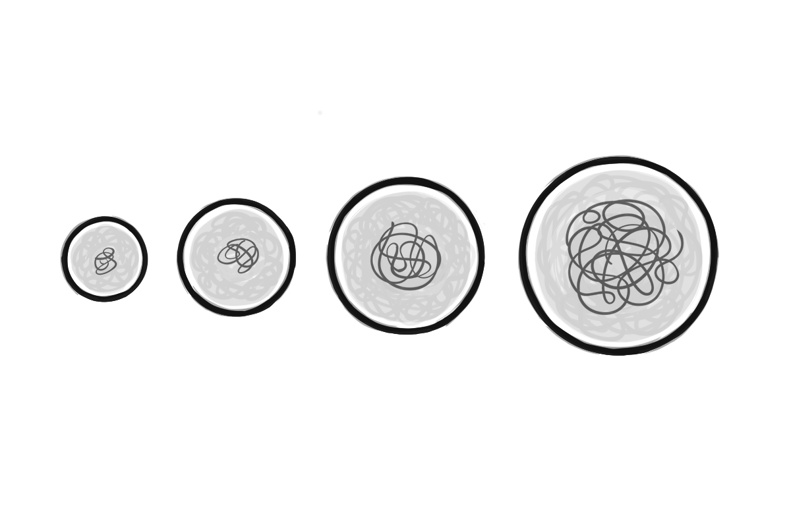
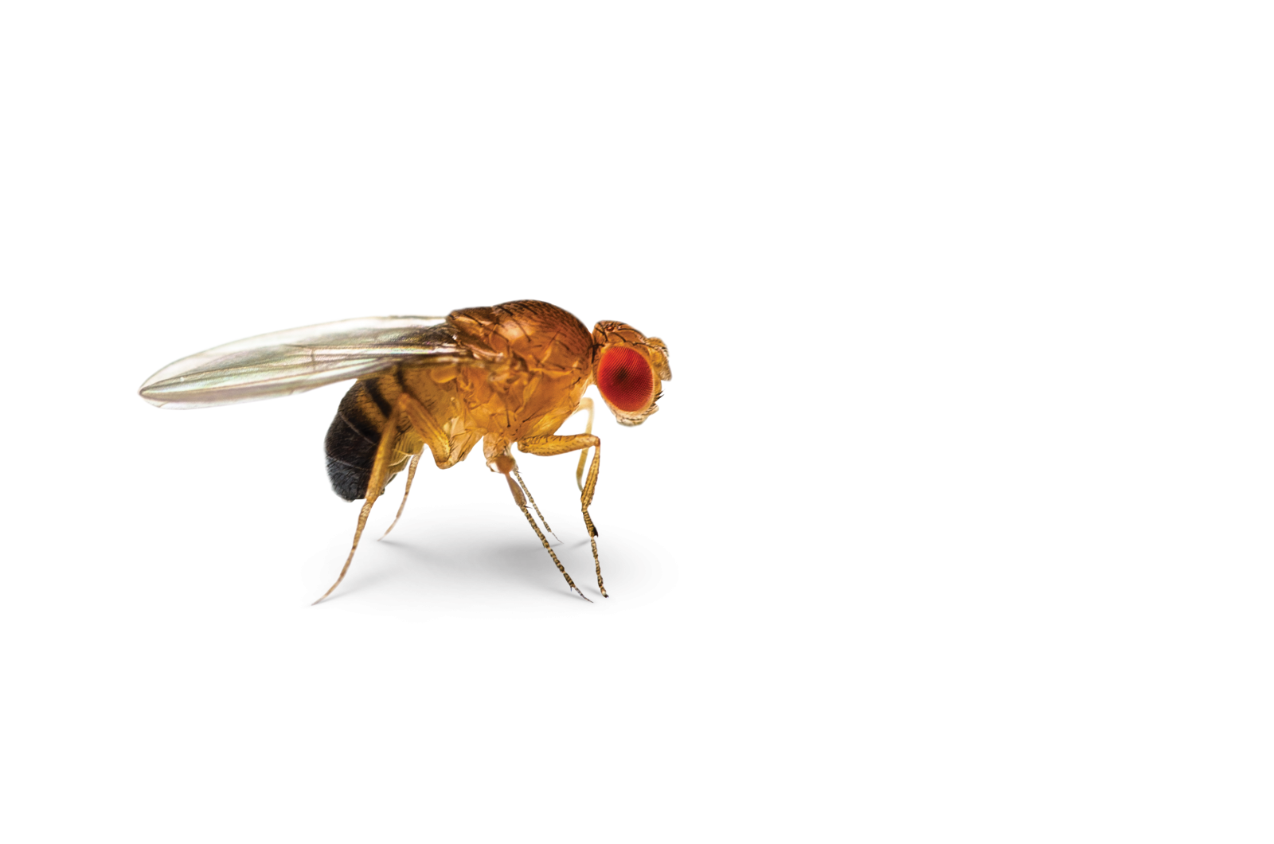
What will we be looking at?
Morphogenesis
Cells simply follow rules
Notes:
Our work will be looking at the inherently interesting subject of morphogenesis, that is, the origin of physical shape. In nature, mind-bogglingly complex shapes, stem from relatively simple parts – no single cell knows the grand plan, but in collaboration, they can form almost anything.

Slide 9
What will we be looking at?
Morphogenesis
Cells simply follow rules
Emergence = ☺
Notes:
Our work will be looking at the inherently interesting subject of morphogenesis, that is, the origin of physical shape. In nature, mind-bogglingly complex shapes, stem from relatively simple parts – no single cell knows the grand plan, but in collaboration, they can form almost anything.
A lot of work has been put into understanding how different patterning organize morphogenesis. Small-scale symmetry breaks in (chemical nonequilibria) leads to large-scale, emergent structure. Some of this interaction is understood, but as everything happens through self-organization, tracing the path of information has been elusive.

Slide 10
What will we be looking at?
Morphogenesis
Cells simply follow rules
Not the first
Emergence = ☺
?
Notes:
Our work will be looking at the inherently interesting subject of morphogenesis, that is, the origin of physical shape. In nature, mind-bogglingly complex shapes, stem from relatively simple parts – no single cell knows the grand plan, but in collaboration, they can form almost anything.
A lot of work has been put into understanding how different patterning organize morphogenesis. Small-scale symmetry breaks in (chemical nonequilibria) leads to large-scale, emergent structure. Some of this interaction is understood, but as everything happens through self-organization, tracing the path of information has been elusive.

Slide 11
What will we be looking at?
Morphogenesis
Cells simply follow rules
Not the first
Emergence = ☺ Chaos theory = ☹
?
Notes:
Our work will be looking at the inherently interesting subject of morphogenesis, that is, the origin of physical shape. In nature, mind-bogglingly complex shapes, stem from relatively simple parts – no single cell knows the grand plan, but in collaboration, they can form almost anything.
A lot of work has been put into understanding how different patterning organize morphogenesis. Small-scale symmetry breaks in (chemical nonequilibria) leads to large-scale, emergent structure. Some of this interaction is understood, but as everything happens through self-organization, tracing the path of information has been elusive.

Slide 12
What are our goals?
Our hypothesis
Spatial (re)programming
Growing organs
Notes:
Our hypothesis is, that if we understand the vocabulary of the individual cell (its rules) we can take that out of the equation, and change biological outcomes by smartly perturbing the initial conditions.
This is what we call spatial (re)programming.
For scientists dreaming big, growing artificial organs as "replacement parts" will revolutionize the health-care industry. A reoccurring problem is that, without us truly understanding why, cells behave wildly different in-vitro (in a lab) compared to in-vivo (in the body). Their environment matter, but figuring out how these boundary conditions affect the cells (i.e. solving the inverse problem) is highly non-trivial.

Slide 13
What do we have?

Slide 14
Proof of concept: Drosophila Melongaster
Master Thesis

Slide 15
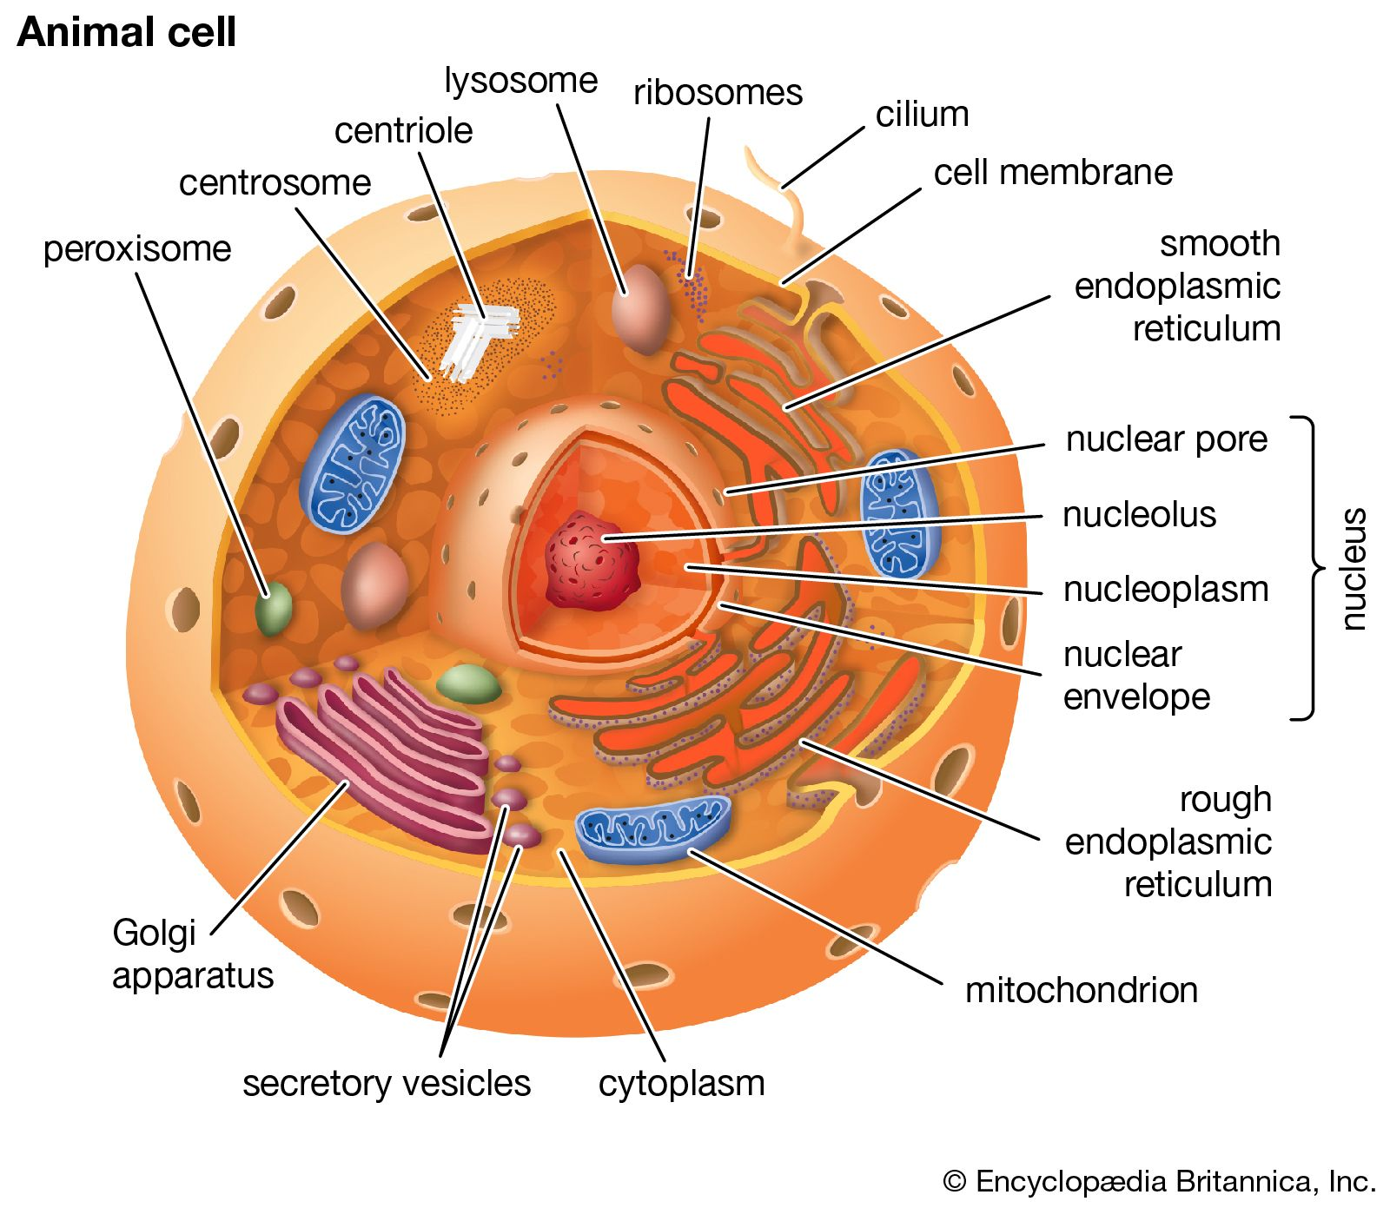
How do physicist see biology?
Notes:
If we know how gravity pulls on a ball and where it started, we can calculate its trajectory.
Local rules lead to global emergent phenomena - but as we know from chaos theory, sometimes a system reacts unintuitively to change.

Slide 16
How do physicist see biology?
differential equations
+ boundary conditions
=
Notes:
If we know how gravity pulls on a ball and where it started, we can calculate its trajectory.
Local rules lead to global emergent phenomena - but as we know from chaos theory, sometimes a system reacts unintuitively to change.

Slide 17
How do physicist see biology?
Not gonna go into the model :(
Notes:
If we know how gravity pulls on a ball and where it started, we can calculate its trajectory.
Local rules lead to global emergent phenomena - but as we know from chaos theory, sometimes a system reacts unintuitively to change.

Slide 18
How do physicist see biology?
Not gonna go into the model :(
Full embryo, never before successful
Notes:
If we know how gravity pulls on a ball and where it started, we can calculate its trajectory.
Local rules lead to global emergent phenomena - but as we know from chaos theory, sometimes a system reacts unintuitively to change.

Slide 19
How do physicist see biology?
Not gonna go into the model :(
Full embryo, never before successful
4-5 parameters
Notes:
If we know how gravity pulls on a ball and where it started, we can calculate its trajectory.
Local rules lead to global emergent phenomena - but as we know from chaos theory, sometimes a system reacts unintuitively to change.

Slide 20
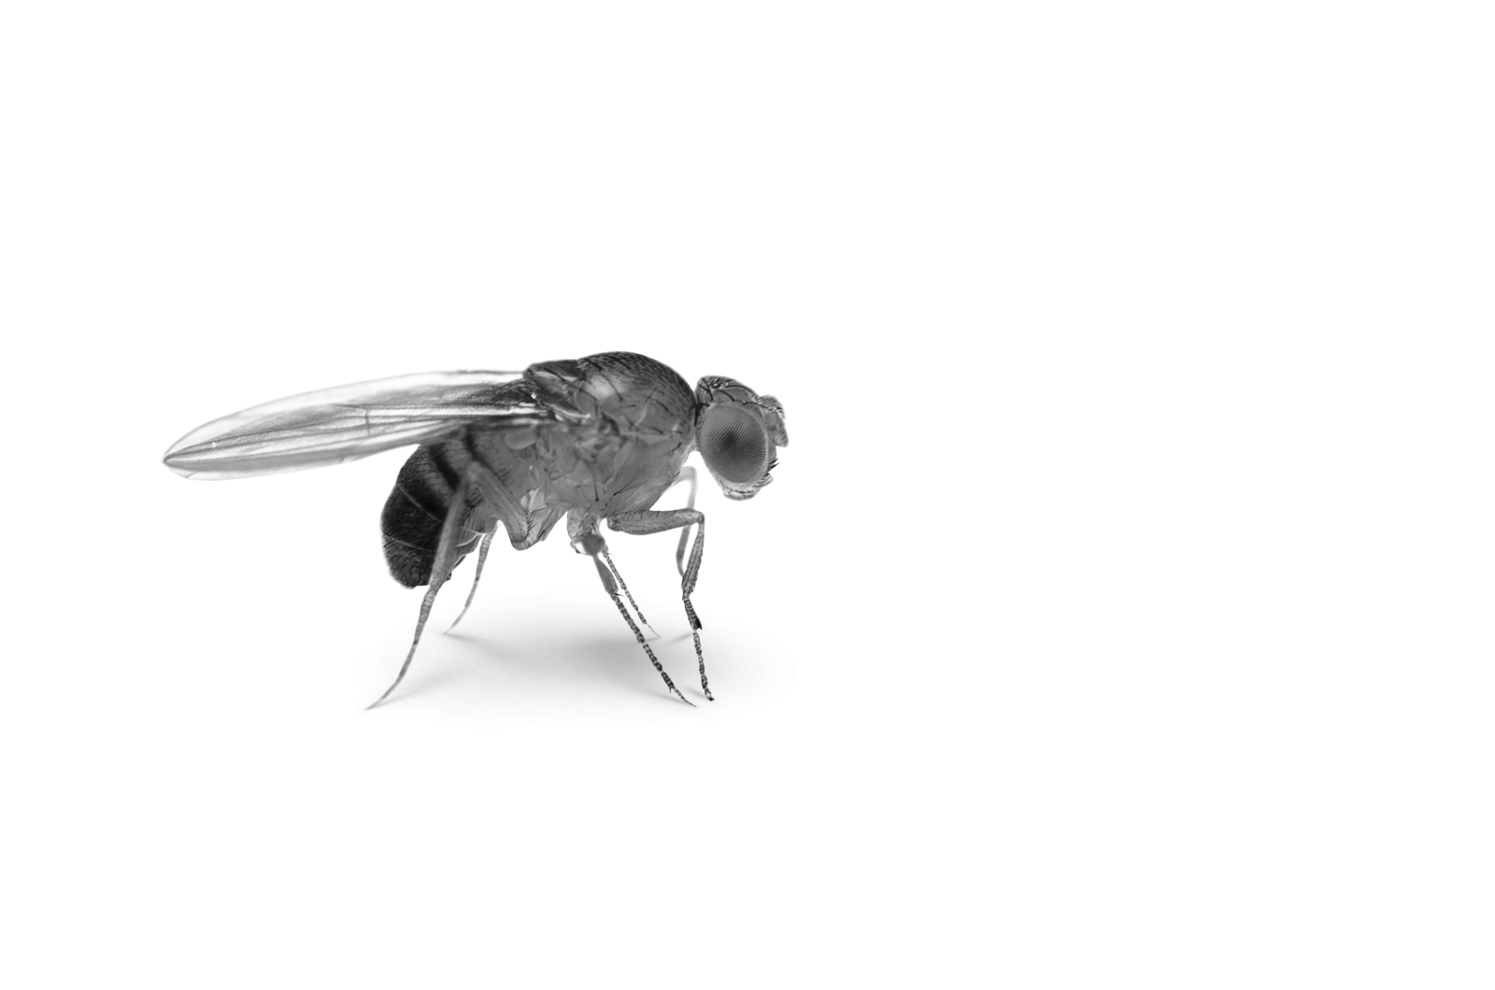
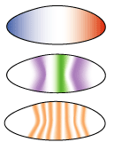
How do physicist see biology?
Not gonna go into the model :(
Full embryo, never before successful
4-5 parameters
Full pipeline: From gene expression (data) to resulting shape
Notes:
If we know how gravity pulls on a ball and where it started, we can calculate its trajectory.
Local rules lead to global emergent phenomena - but as we know from chaos theory, sometimes a system reacts unintuitively to change.

Slide 21
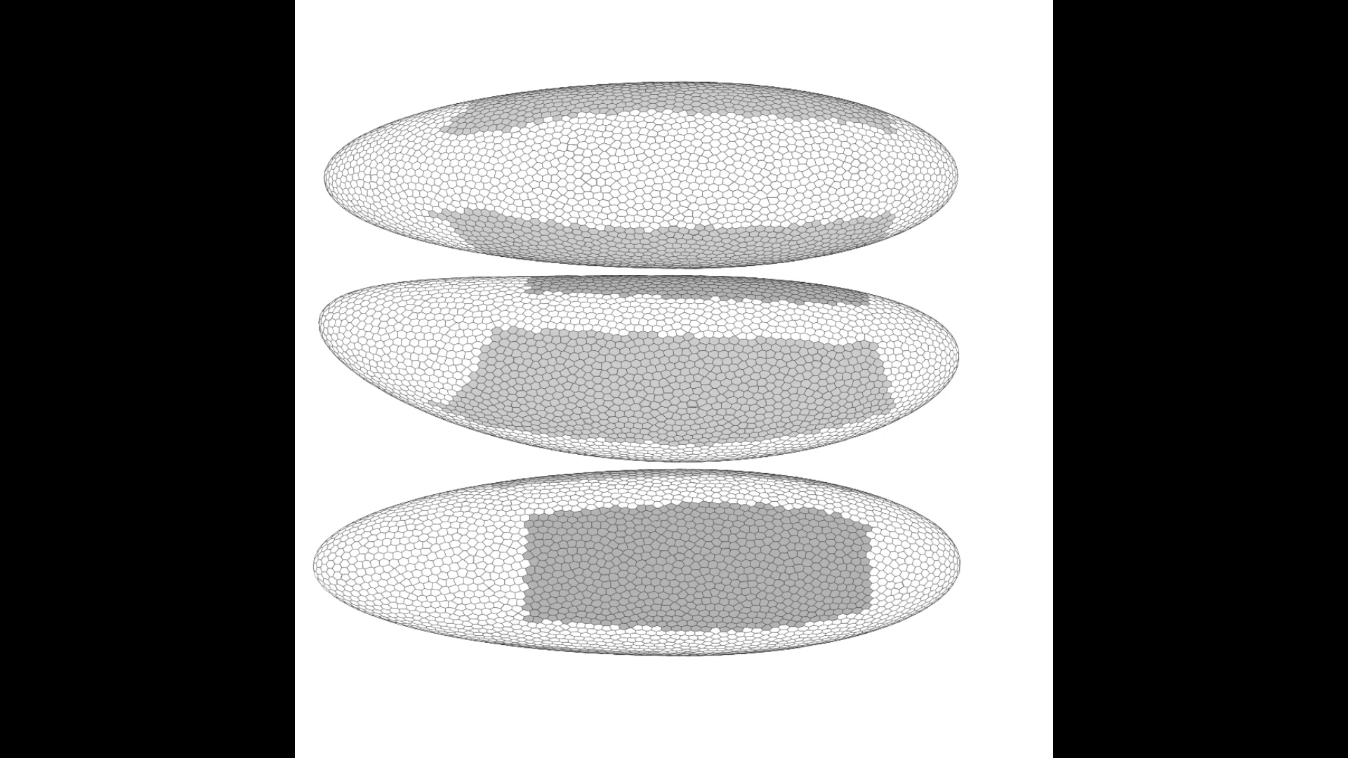
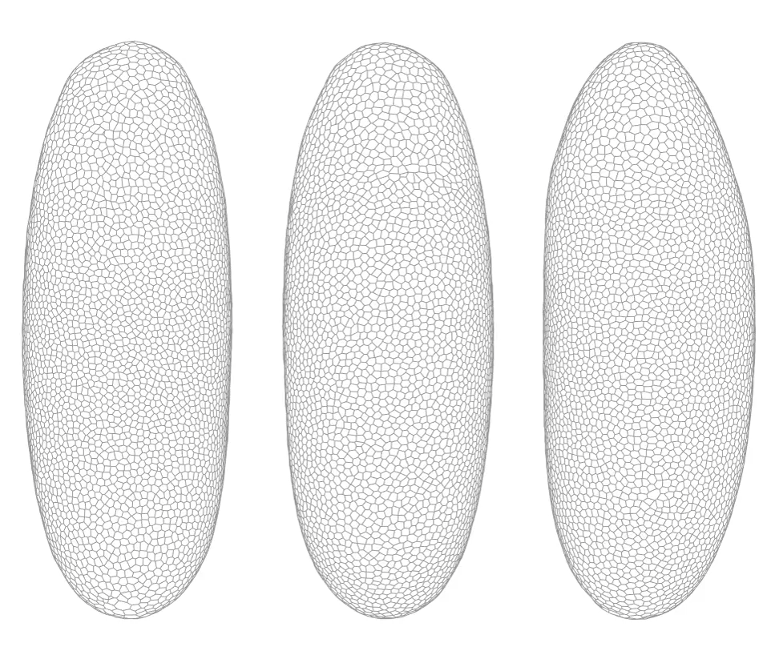
Data
Simulation

Slide 22
Six months of my life in a 10 second video

Slide 23
What will we be doing now?
Experiments
Neural Cellular Automata
Defining the spatial (re)programming

Slide 24
Experiments
We said “We can do science! We have predictions. Validate them”

Slide 25
Experiments
We said “We can do science! We have predictions. Validate them”
Biologists said “Do it yourself”

Slide 26
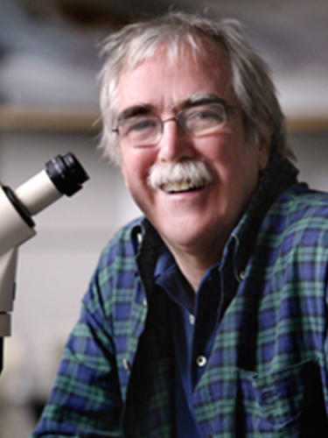
Experiments
We said “We can do science! We have predictions. Validate them”
Biologists said “Do it yourself”

Slide 27
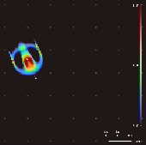
Neural Cellular Automata

Slide 28
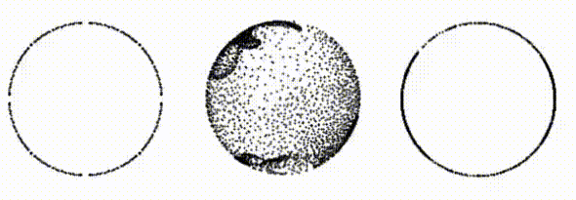
Neural Cellular Automata

Slide 29
Summary
Everything is just a list of rules and corresponding BC’s
Emulate/create biology
Understanding the rules allows us to perturb the BC’s
Spatial reprogramming!

Slide 30
Thank you for listening!
Always remember: You are spatial <3

